Slide 1
Implement VTP
LAN Switching and Wireless – Chapter 4

Slide 2
Objectives
Explain the role of VTP in a converged switched network
Describe the operation of VTP: VTP domains, VTP Modes, VTP Advertisements, and VTP Pruning.
Configure VTP on the switches in a converged network.

Slide 3
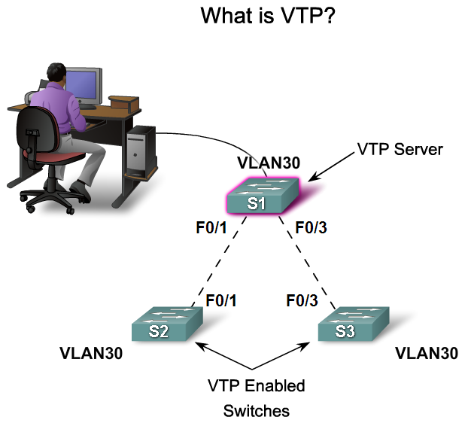
Explain the Role of VTP in a Converged Switched Network
Explain the role of VTP in a multi-switch network

Slide 4
VLAN Trunking Protocol (VTP)
VTP allows a network manager to configure a switch so that it will propagate VLAN configurations to other switches in the network. The switch can be configured in the role of a VTP server or a VTP client.
VTP allows a network manager to makes changes on a switch that is configured as a VTP server
VTP server distributes and synchronizes VLAN information to VTP-enabled switches throughout the switched network, which minimizes the problems caused by incorrect configurations and configuration inconsistencies.
VTP stores VLAN configurations in the VLAN database called vlan.dat.

Slide 5
Benefits of VTP
VLAN configuration consistency across the network
Accurate tracking and monitoring of VLANs
Dynamic reporting of added VLANs across a network
Dynamic trunk configuration when VLANs are added to the network

Slide 6
VTP Components
VTP Domain - Consists of one or more interconnected switches. All switches in a domain share VLAN configuration details using VTP advertisements. A router or Layer 3 switch defines the boundary of each domain.
VTP Advertisements - VTP uses a hierarchy of advertisements to distribute and synchronize VLAN configurations across the network.
VTP Modes - A switch can be configured in one of three modes: server, client, or transparent.

Slide 7
VTP Components
VTP Server - VTP servers advertise the VTP domain VLAN information to other VTP-enabled switches in the same VTP domain. VTP servers store the VLAN information for the entire domain in NVRAM. The server is where VLANs can be created, deleted, or renamed for the domain.
VTP Client - VTP clients function the same way as VTP servers, but you cannot create, change, or delete VLANs on a VTP client. A VTP client only stores the VLAN information for the entire domain while the switch is on. A switch reset deletes the VLAN information. You must configure VTP client mode on a switch.

Slide 8
VTP Components
VTP Transparent - Transparent switches forward VTP advertisements to VTP clients and VTP servers. Transparent switches do not participate in VTP. VLANs that are created, renamed, or deleted on transparent switches are local to that switch only.
VTP Pruning - VTP pruning increases network available bandwidth by restricting flooded traffic to those trunk links that the traffic must use to reach the destination devices. Without VTP pruning, a switch floods broadcast, multicast, and unknown unicast traffic across all trunk links within a VTP domain even though receiving switches might discard them.

Slide 9
VTP is an acronym for VLAN Trunking Protocol
VTP is a Layer 2 Messaging protocol that maintains VLAN configuration consistency by managing the addition, deletion, and renaming of VLANs across multiple Cisco Switches in a network.
VTP is a proprietary protocol available only on Cisco switches.
In VTP server mode, you can create, modify, or delete VLANs for entire VTP domain.
In VTP transparent mode, the switch does not participate in VTP, however, the switch does forward VTP advertisements through trunk interfaces.

Slide 10
In VTP client mode, you cannot create, modify, or delete VLANs
In VTP client mode, VLAN configurations are not save in NVRAM.
VTP Transparent mode allows you to create, modify and delete VLANs n the single switch without affecting the rest of the switch in your network.
VTP server mode is the default mode for a Cisco switch.

Slide 11
Default VTP Configuration
The benefit of VTP is that it automatically distributes and synchronizes domain and VLAN configurations across the network.
However, this benefit comes with a cost, you can only add switches that are in their default VTP configuration.
If you add a VTP-enabled switch that is configured with settings that supersede existing network VTP configurations, changes that are difficult to fix are automatically propagated throughout the network. So make sure that you only add switches that are in their default VTP configuration.

Slide 12
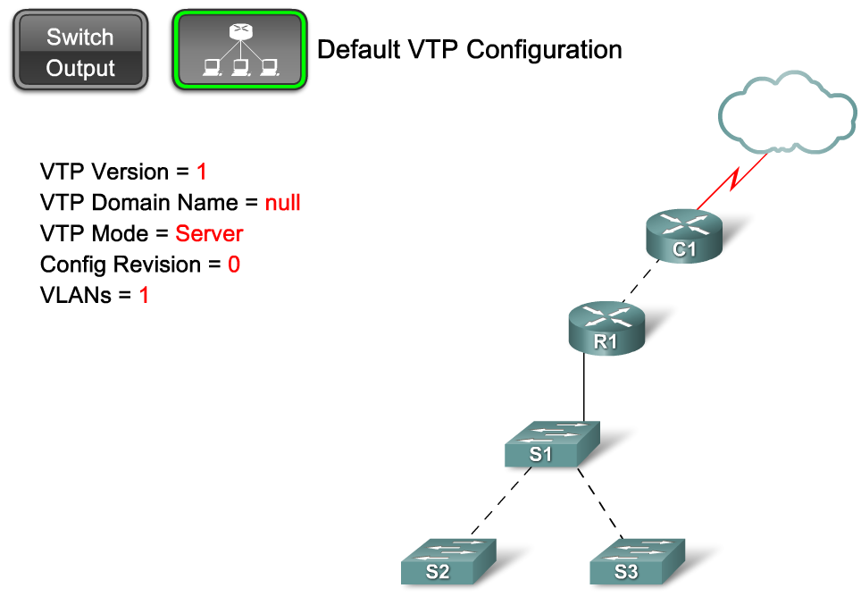
Default VTP Configuration

Slide 13
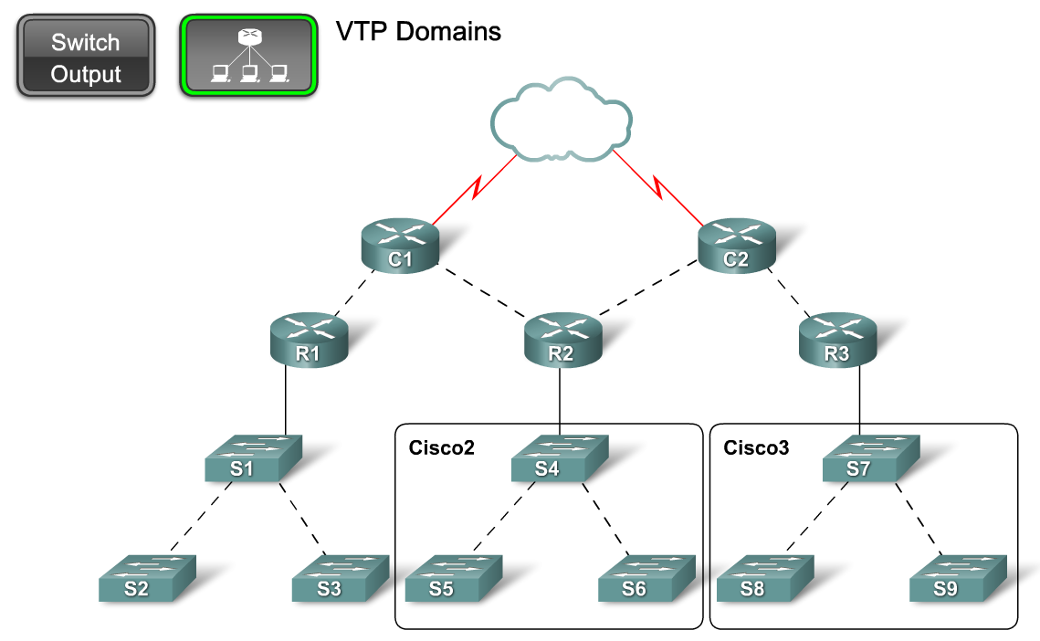
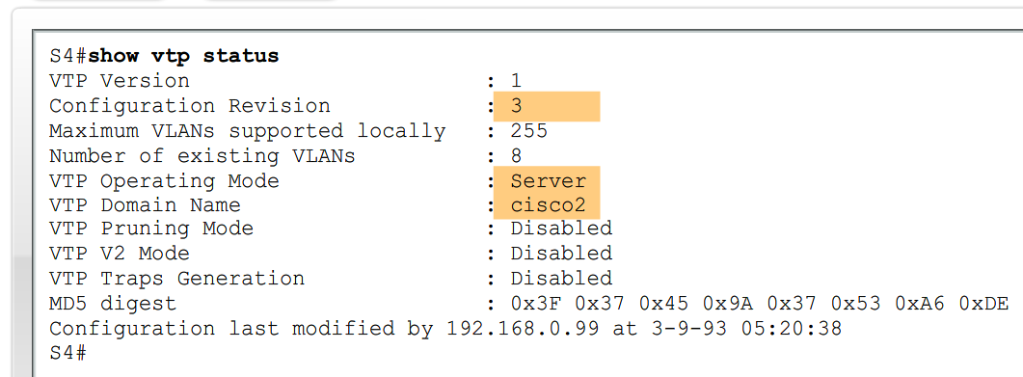
Describe the Operation of VTP
Explain the role of domains in VTP

Slide 14
VTP Domains
VTP allows you to separate your network into smaller management domains to help reduce VLAN management.
An additional benefit of configuring VTP domains is that it limits the extent to which configuration changes are propagated in the network if an error occurs.
A VTP domain consists of one switch or several interconnected switches sharing the same VTP domain name.
A switch can be a member of only one VTP domain at a time. Until the VTP domain name is specified you cannot create or modify VLANs on a VTP server, and VLAN information is not propagated over the network.

Slide 15
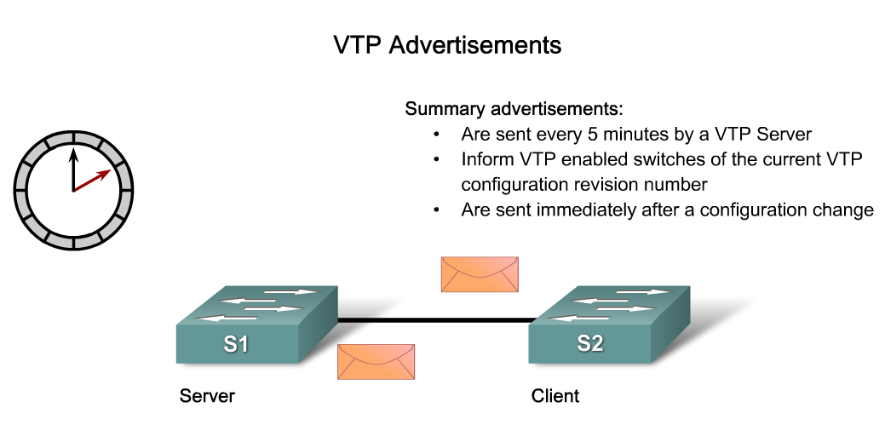
Describe the Operation of VTP
Describe how VTP exchanges domain and VLAN information between switches in the same VTP domain

Slide 16
VTP Domain Name Propagation
For a VTP server or client switch to participate in a VTP-enabled network, it must be a part of the same domain.
When switches are in different VTP domains, they do not exchange VTP messages.
A VTP server propagates the VTP domain name to all switches for you.
Domain name propagation uses three VTP components: servers, clients, and advertisements.

Slide 17
VTP advertisements
VTP advertisements (or messages) distribute VTP domain name and VLAN configuration changes to VTP-enabled switches.

Slide 18
VTP Frame Encapsulation
A VTP frame consists of a header field and a message field.
The VTP information is inserted into the data field of an Ethernet frame.
The Ethernet frame is then encapsulated as a 802.1Q trunk frame (or ISL frame).
Each switch in the domain sends periodic advertisements out each trunk port to a reserved multicast address.
These advertisements are received by neighboring switches, which update their VTP and VLAN configurations as necessary.

Slide 19
VTP Frame Details
Destination MAC address - which is the reserved multicast address for all VTP messages.
LLC field - Logical link control (LLC) field contains a destination service access point (DSAP) and a source service access point (SSAP) set to the value of AA.
SNAP field - Subnetwork Access Protocol (SNAP) field has an OUI set to AAAA and type set to 2003.
VTP header field - The contents vary depending on the VTP message type-summary, subset, or request, but it always contains these VTP fields:
  Domain name; Domain name length; Version; and Configuration revision number

Slide 20
VTP Message Contents
VTP frames contain the following fixed-length global domain information:
  VTP domain name
  Identity of the switch sending the message, and the time it was sent
  MD5 digest VLAN configuration, including maximum transmission unit (MTU) size for each VLAN
  Frame format: ISL or 802.1Q

Slide 21
VTP Message Contents
VTP frames contain the following information for each configured VLAN:
  VLAN IDs (IEEE 802.1Q)
  VLAN name
  VLAN type
  VLAN state
Additional VLAN configuration information specific to the VLAN type

Slide 22
VTP Revision Number
The configuration revision number is a 32-bit number that indicates the level of revision for a VTP frame.
The default configuration number for a switch is zero. Each time a VLAN is added or removed, the configuration revision number is incremented. Each VTP device tracks the VTP configuration revision number that is assigned to it.
Note: A VTP domain name change does not increment the revision number. Instead, it resets the revision number to zero.

Slide 23
Summary Advertisements
The summary advertisement contains the VTP domain name, the current revision number, and other VTP configuration details.
Summary advertisements are sent:
  Every 5 minutes by a VTP server or client to inform neighboring VTP-enabled switches of the current VTP configuration revision number for its VTP domain
  Immediately after a configuration has been made

Slide 24
Subset Advertisements
A subset advertisement contains VLAN information. Changes that trigger the subset advertisement include:
  Creating or deleting a VLAN
  Suspending or activating a VLAN
  Changing the name of a VLAN
  Changing the MTU of a VLAN
It may take multiple subset advertisements to fully update the VLAN information.

Slide 25
Request Advertisements
When a request advertisement is sent to a VTP server in the same VTP domain, the VTP server responds by sending a summary advertisement and then a subset advertisement.
Request advertisements are sent if:
  The VTP domain name has been changed
  The switch receives a summary advertisement with a higher configuration revision number than its own
  A subset advertisement message is missed for some reason
  The switch has been reset

Slide 26
VTP Advertisements Details
VTP uses advertisements to distribute and synchronize information about domains and VLAN configurations.
There are three main VTP advertisements.
  Summary Advertisements
  Subset Advertisements
  Request Advertisements
Each type of VTP advertisement sends information about several parameters used by VTP.

Slide 27
VTP Advertisements Details
Summary Advertisements - Summary advertisements comprise the majority of VTP advertisement traffic.
Subset Advertisements - The fields found in a subset advertisement are briefly described. The fields in the VLAN-info are not described.
Request Advertisements -The fields found in a request advertisement are briefly described.

Slide 28
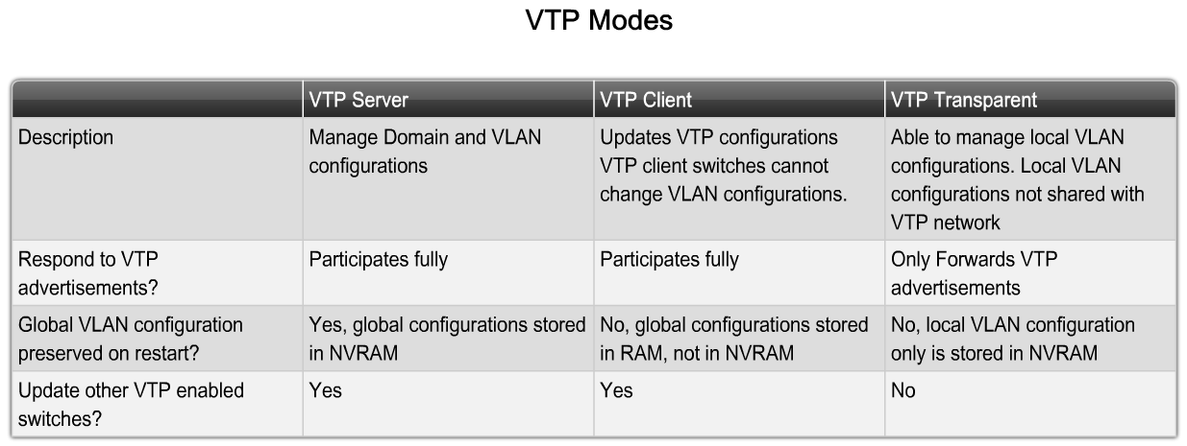
VTP Modes Overview

Slide 29
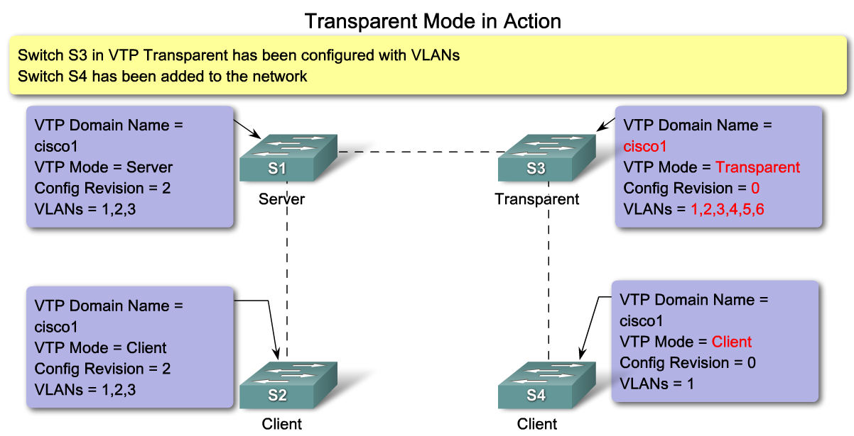
Describe the Operation of VTP
Describe the role VTP modes play in enabling VTP to distribute and synchronize domain and VLAN configuration information in a network

Slide 30
VTP Pruning
VTP pruning prevents unnecessary flooding of broadcast information from one VLAN across all trunks in a VTP domain.
VTP pruning permits switches to negotiate which VLANs are assigned to ports at the other end of a trunk and, hence, prune the VLANs that are not assigned to ports on the remote switch.
Pruning is disabled by default. VTP pruning is enabled using the vtp pruning global configuration command. You need to enable pruning on only one VTP server switch in the domain

Slide 31
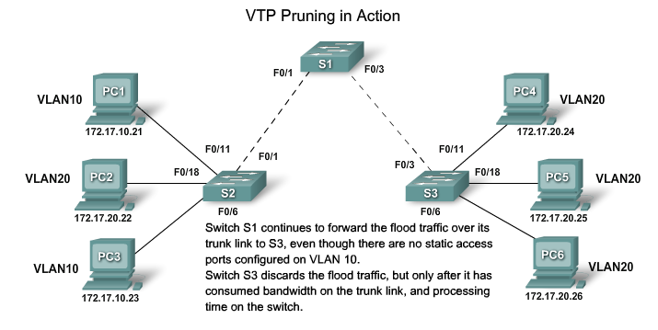
Describe the Operation of VTP
Explain how VTP pruning functions

Slide 32
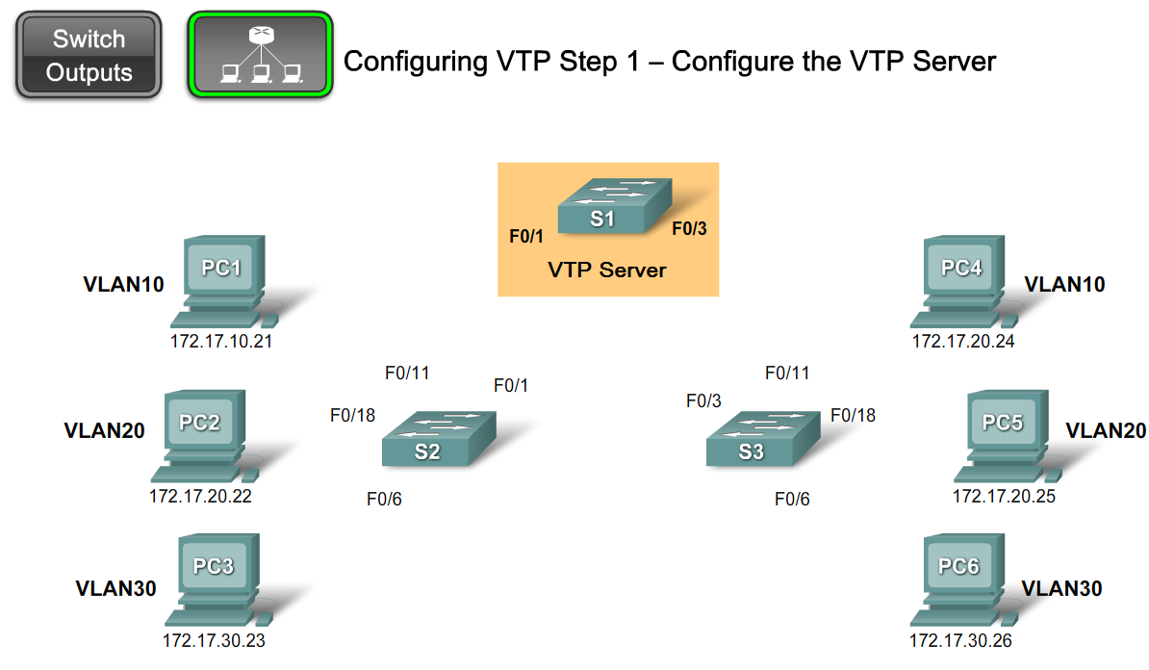
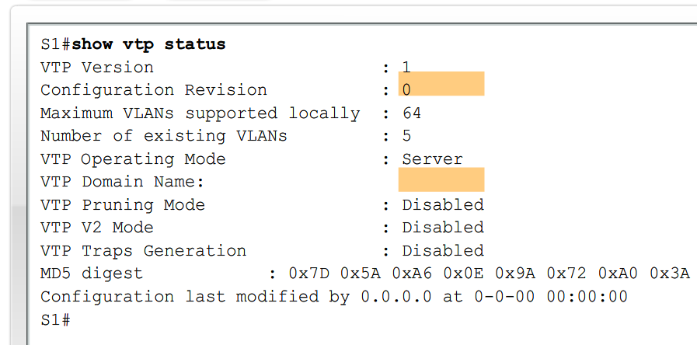
Configure VTP on the Switches in a Converged Network
Configure VTP on a Cisco Catalyst Switch

Slide 33
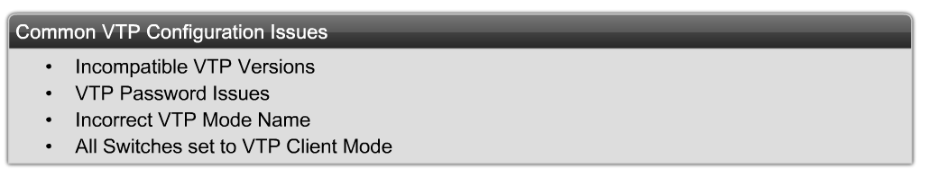
Configure VTP on the Switches in a Converged Network
Identify and troubleshoot common VTP configuration problems

Slide 34
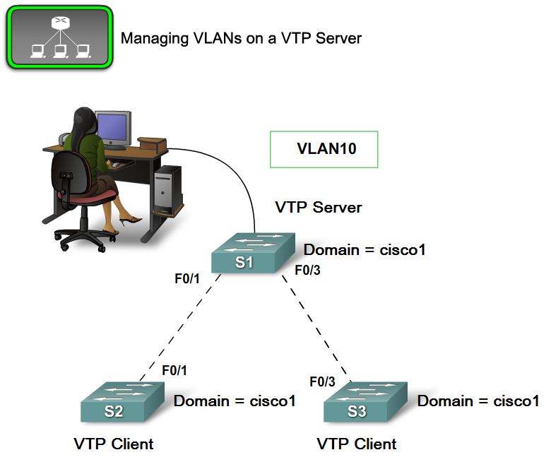
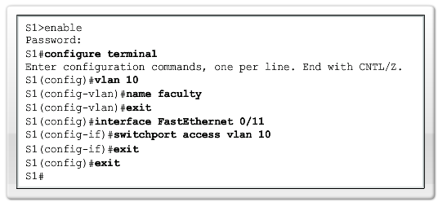
Configure VTP on the Switches in a Converged Network
Manage VLANs on a VTP enabled network

Slide 35
Summary
VTP is a Cisco proprietary protocol used to exchange VLAN information across trunk links.
A switch can be in one of 3 VTP operating modes
  Client
    Cannot create, modify or delete VLAN
  Server
    Can create, modify & delete VLAN
  Transparent
  Can create, modify, & delete LOCAL VLAN
  Forwards VTP advertisements.

Slide 36
Summary
VTP pruning
  Limits unnecessary dissemination of VLAN information.
Verify VTP configuration
  Show VTP status
  Show interfaces trunk

